Slide 1

Intro to REST APIs
Presenting: Dr. Aaron Hamachi and Alexander Stevenson
Lab: Adrian Iliesiu
WASTC 2024 virtual Faculty Development Weeks (vFDW)
2B – Set a New Course with DevNet Automation Technologies
Week 2, June 24 – 28

Slide 2
Agenda
API Basics
Evolution of Web Services
REST Explained
HTTP Methods
Consuming a REST API
Designing RESTful APIs
Security
Best Practices
Using Postman
Q&A

Slide 3
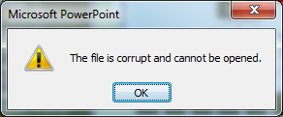

Slide 4
Oh No!
We need to download a clean version of this PPT. How can we?
All we have is the URL:
https://github.com/CiscoDevNet/WASTC2024-vFDW/blob/main/1-Monday/Intro-to-REST-APIs/Intro-to-REST-APIs.pptx
We’re on a constrained edge device with no browser and no PuTTY / FTP client!
How can we download it onto our device?

Slide 5
cURL to the Rescue!
curl -L -o 'Intro-to-REST-APIs.pptx' https://raw.githubusercontent.com/CiscoDevNet/WASTC2024-vFDW/main/1-Monday/Intro-to-REST-APIs/Intro-to-REST-APIs.pptx

Slide 6

cURL is a versatile utility accessible from the command line, designed to communicate with servers via HTTP. It facilitates the transfer of data both to and from a server and supports multiple protocols, among which HTTP and HTTPS are predominantly utilized for interfacing with web APIs.
cURL can be used as a way to manually test and interact with REST APIs, but they are fundamentally different things—one is a tool, and the other is a set of principles for building web services.

Slide 7
How cURL is related to REST APIs
HTTP Verbs: curl can specify HTTP methods through command-line options like -X GET or -X POST, which correspond to the operations you would perform with a REST API.
Data Formats: curl can send and receive data in different formats. For instance, to work with a REST API that communicates with JSON, you can include JSON-formatted data in your curl command and set the appropriate headers (e.g., Content-Type: application/json).
Headers: curl allows you to set HTTP headers with the -H flag, which is often necessary for REST API interactions, such as specifying content types or providing authentication tokens.
URLs: REST APIs use URLs to identify resources. curl uses URLs as the target for its operations, just like REST API clients do.

Slide 8


API Basics

Slide 9
API
An API is an Application Programming Interface.
APIs enable two pieces of software to communicate with each other.
To understand any API, start by studying the documentation.
To put together an HTTP request to send to the server, you need to know what the server expects and at which endpoint, including the data formats it wants, and any parameters, optional or required.
Parameters often provide details so that you can scope, filter, or clarify a request. These parameters are usually optional. They can streamline your request or enable you to retrieve information page-by-page.

Slide 10
Base URLs https://developer.cisco.com/docs/service-apis/services-apis-base-urls/ API Features https://developer.cisco.com/docs/service-apis/general-api-features/#general-api-features
Start by Studying the Documentation
Documentation for Cisco Services APIs

Slide 11
Getting Started https://developer.cisco.com/meraki/api-v1/getting-started/#getting-started
Start by Studying the Documentation
Documentation for Meraki Dashboard API
Notes:
6bec40cf957de430a6f1f2baa056b99a4fac9ea0

Slide 12
Getting Started https://developer.cisco.com/docs/nexus-dashboard-fabric-controller/12-2-1/getting-started/#getting-started
Start by Studying the Documentation
Documentation for Nexus Dashboard Fabric Controller API
Notes:
6bec40cf957de430a6f1f2baa056b99a4fac9ea0

Slide 13
Evolution of Web Services: SOAP vs. REST

Slide 14
SOAP vs. REST
SOAP (Simple Object Access Protocol)
REST (Representational State Transfer)
Protocol-based (uses XML)
Strict standards and high overhead
Requires SOAP envelope
Built-in error handling with fault elements
Security through WS-Security
Stateful operations possible
Less cache-friendly
Architectural style (uses multiple formats including JSON, XML)
Flexible and lightweight
No envelope, directly uses HTTP methods
Uses standard HTTP status codes for errors
Security through HTTPS, OAuth, API keys, etc.
Stateless by design
Cacheable (improves scalability and performance)

Slide 15
Transition from SOAP to REST
In the evolution of web services, we've seen a transition from the use of SOAP to REST. SOAP is a protocol that strictly adheres to XML and comes with a significant overhead due to its message envelope structure. It was the standard for web services due to its built-in error handling and security specifications.

Slide 16
Why REST has gained in popularity: simplicity & performance
REST is not a protocol but an architectural style that supports multiple data formats, making it more flexible.
It directly leverages HTTP methods without the need for an envelope, which reduces complexity and improves speed.
Unlike SOAP, REST is stateless, which promotes scalability, and its responses are cacheable, enhancing performance.
The shift towards REST is largely driven by its lightweight nature and its ability to seamlessly integrate with modern web technologies.

Slide 17

Now that we’ve seen what an API is,
let’s take a step back and understand the RESTful architecture which our APIs flow through.
Notes:
6bec40cf957de430a6f1f2baa056b99a4fac9ea0

Slide 18
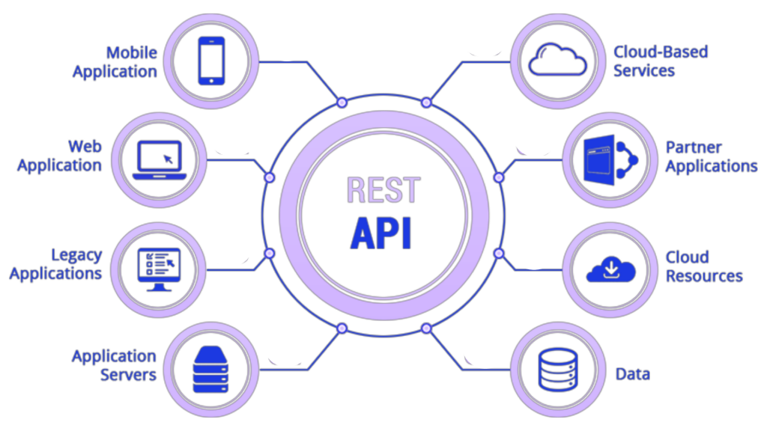
REST Explained

Slide 19
REST
REST stands for REpresentational State Transfer and is just another use for the HTTP Protocol where all requests and responses are sent over TCP/TLS connections using text.
REST is a client-server architecture.
REST is stateless.
REST is cacheable.
REST provides a uniform interface between components.
REST is a layered system.
REST optionally provides code-on-demand.

Slide 20
REST is a client-server architecture…
…which means that the client (such as a user's web browser or mobile application) and the server (which provides the resource or service) operate independently of each other. This separation allows clients and servers to evolve separately, improving scalability and simplifying components on both sides. Clients are not concerned with data storage, which remains internal to each server, and the server is not concerned with the user interface or user state, so that servers can be simpler and more scalable.

Slide 21
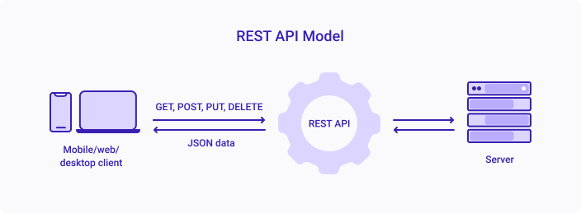
Client-Server Architecture

Slide 22
REST is stateless…
…so each request from a client to a server must contain all the information needed to understand and complete the request. The server does not retain any session information or status about the client between requests. This means that each request is independent and separate, which simplifies server design, improves reliability, and enhances scalability by allowing requests to be serviced by different server processes or even by different servers altogether.

Slide 23
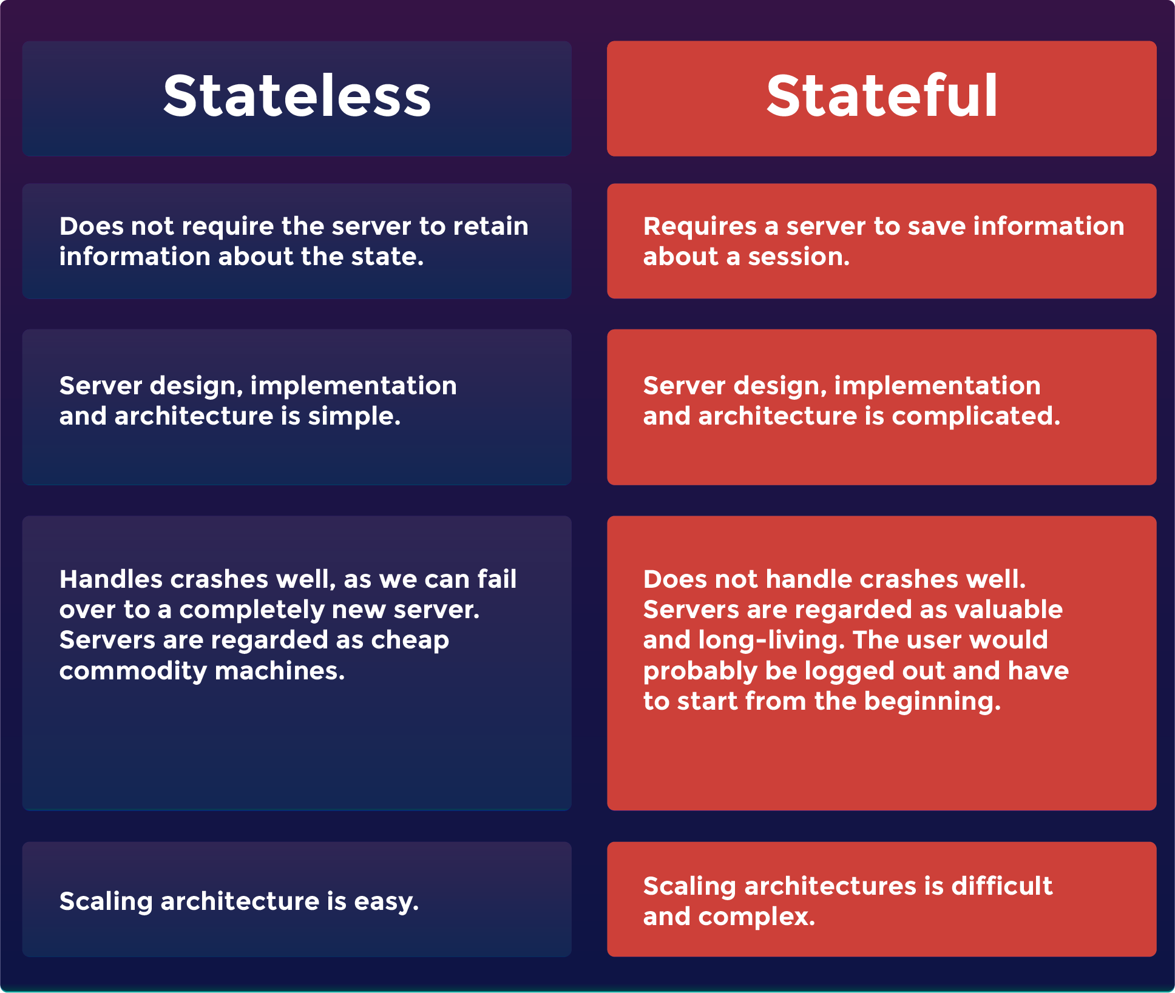
Stateless vs. Stateful

Slide 24
REST is cacheable.
Responses in RESTful systems can be explicitly marked as cacheable or non-cacheable, which means that clients and intermediaries can store cacheable responses to reuse for later, equivalent requests. This cacheability reduces the need for some client-server interactions, decreases server load, and improves overall system efficiency and performance. Properly managed caching partially or completely eliminates some client-server interactions, further enhancing the scalability and performance of the service.

Slide 25
REST provides a uniform interface between components.
The uniform interface between components simplifies and decouples the architecture, which allows each component to evolve independently. A RESTful system operates on resources (any information that can be named) through a consistent and predefined set of operations (such as HTTP GET, POST, PUT, DELETE), and it uses a standard way of communicating resource representations over a network. This uniformity reduces the learning curve for developers, fosters greater understanding of the system, and enhances the ability to diagnose problems.

Slide 26
REST is a layered system.
REST allows the use of a layered system architecture to organize servers into hierarchies of layers. Each layer can only "see" the immediate layer with which it is interacting. This means that a client might be connected to an intermediary server (like a load balancer or a proxy) rather than the end server actually providing the service. Layered systems enhance security (due to the ability to restrict components to certain layers) and allow components to be added, removed, modified, or replaced without affecting the rest of the system.

Slide 27
REST optionally provides code-on-demand.
REST's optional code-on-demand feature allows servers to extend the functionality of a client by transferring executable code, such as Java applets or JavaScript. This can be useful for supporting a part of the application that changes frequently or dynamically, without the need for redeploying the client. It's the least used constraint of REST because it relies on the client being able to execute the code safely and can complicate the client application. However, when used appropriately, it can greatly enhance the flexibility and power of the client-server interaction.

Slide 28
REST Data Formats
When sending a request, data formats are also called payloads. Refer to the REST API Documentation for your product to learn if it supports JSON and XML as data formats.
JSON stands for JavaScript Object Notation. It's a lightweight text-based open standard designed for human-readable data interchange. You can read more about it at http://www.json.org/. Many REST APIs work with JSON.
XML stands for eXtensible Markup Language. It is a language designed to store and transport data.

Slide 29
REST Data Formats
{
"user": {
"id": 123,
"firstName": "John",
"lastName": "Doe",
"email": "john.doe@example.com"
}
}

Slide 30
REST Data Formats
<user>
<id>123</id>
<firstName>John</firstName>
<lastName>Doe</lastName>
<email>john.doe@example.com</email>
</user>

Slide 31
REST Data Formats
When sending a request, data formats are also called payloads. Refer to the REST API Documentation for your product to learn if it supports JSON and/or XML as data formats.
JSON stands for JavaScript Object Notation. It's a lightweight text-based open standard designed for human-readable data interchange. You can read more about it at http://www.json.org/. Many REST APIs work with JSON.
XML stands for eXtensible Markup Language. It is a language designed to store and transport data.

Slide 32
HTTP Methods

Slide 33
HTTP Methods
For each data format, the data may be contained in the body of the request. POST, PUT, and PATCH requests typically include data requirements or optional parameters as part of the request.
HTTP Verb | Typical Action (CRUD)
POST | Create
GET | Read
PUT | Update
PATCH | Update
DELETE | Delete

Slide 34

HTTP Methods
You might be asking yourself, what’s the difference between a
PUT and a PATCH? They both Update….
HTTP Verb | Typical Action (CRUD)
POST | Create
GET | Read
PUT | Update
PATCH | Update
DELETE | Delete

Slide 35


Consuming a REST API

Slide 36
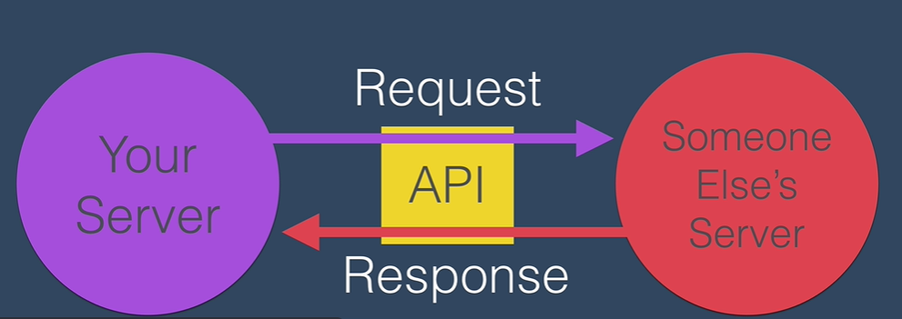
Consuming a REST API - Overview
Interacting with a REST API involves making HTTP requests to specific endpoints and processing the responses.
To consume a REST API, we make HTTP requests to the API's endpoints, and the server sends back responses.

Slide 37
Making a Request - The Components
An HTTP request is made up of the following components:
HTTP Method (e.g., GET, POST, PUT, DELETE)
Endpoint URL (e.g., https://api.example.com/users)
Headers (e.g., Content-Type, Authorization)
Body (for methods like POST or PUT, containing data to send)

Slide 38
Handling Responses
A server response to an HTTP request includes::
Status Code (e.g., 200 OK, 404 Not Found)
Headers (e.g., Content-Type, Cache-Control)
Body (the data returned by the server, often JSON or XML format)

Slide 39
Categories of Status Codes
1xx (Informational): The request was received, continuing process.
2xx (Success): The request was successfully received, understood, and accepted.
3xx (Redirection): Further action needs to be taken in order to complete the request.
4xx (Client Error): The request contains bad syntax or cannot be fulfilled.
5xx (Server Error): The server failed to fulfill an apparently valid request.

Slide 40
Common Status Codes
200 OK: The request has succeeded.
201 Created: The request has been fulfilled and resulted in a new resource being created.
400 Bad Request: The server cannot or will not process the request due to an apparent client error.
401 Unauthorized: Authentication is required and has failed or has not yet been provided.

Slide 41
Common Status Codes (continued)
403 Forbidden: The server understood the request, but is refusing to fulfill it.
404 Not Found: The requested resource could not be found but may be available in the future.
500 Internal Server Error: A generic error message, given when an unexpected condition was encountered.
503 Service Unavailable: The server is currently unable to handle the request due to a temporary overload or maintenance.

Slide 42
Designing RESTful APIs

Slide 43
Design Principles for RESTful APIs
Consistency: Ensure consistent naming conventions, request/response formats, and URL structures throughout the API.
Resource Identification: Use clear, descriptive, and plural nouns for resource names (e.g., /users, /products) and avoid verbs.
Stateless Interactions: Each API call should contain all information necessary to process the request without relying on stored context.
Versioning: Version your API to manage changes and maintain backward compatibility (e.g., /v1/users).
Error Handling: Provide informative error messages with appropriate HTTP status codes to facilitate debugging.

Slide 44
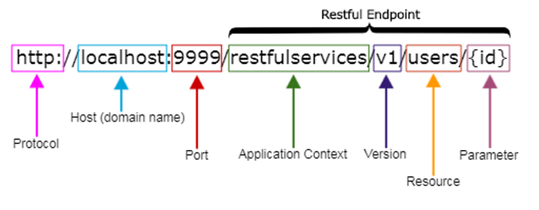
REST API Naming Conventions and Best Practices
Source: https://medium.com/@nadinCodeHat/rest-api-naming-conventions-and-best-practices-1c4e781eb6a5

Slide 45
Use Nouns to represent resources / Not Verbs
Bad examples
Good examples
http://api.example.com/v1/store/CreateItems/{item-id}
http://api.example.com/v1/store/getEmployees/{emp-id}
http://api.example.com/v1/store/update-prices/{price-id}
http://api.example.com/v1/store/deleteOrders/{order-id}
http://api.example.com/v1/store/items/{item-id}
http://api.example.com/v1/store/employees/{emp-id}
http://api.example.com/v1/store/prices/{price-id}
http://api.example.com/v1/store/orders/{order-id}

Slide 46
Use Pluralized Nouns for resources
Bad examples
Good examples
http://api.example.com/v1/store/item/{item-id}
http://api.example.com/v1/store/employee/{emp-id}/address
http://api.example.com/v1/store/items/{item-id}
http://api.example.com/v1/store/employees/{emp-id}/address

Slide 47
Use hyphens (-) to improve the readability of URIs
Bad examples
Good examples
http://api.example.com/v1/store/vendormanagement/{vendor-id}
http://api.example.com/v1/store/itemmanagement/{item-id}/producttype
http://api.example.com/v1/store/inventory_management
http://api.example.com/v1/store/vendor-management/{vendor-id}
http://api.example.com/v1/store/item-management/{item-id}/product-type
http://api.example.com/v1/store/inventory-management

Slide 48
Use forward slashes (/) for hierarchy but not trailing forward slash (/)
Bad examples
Good examples
http://api.example.com/v1/store/items/
http://api.example.com/v1/store/items

Slide 49
Avoid using file extensions
Bad examples
Good examples
http://api.example.com/v1/store/items.json
http://api.example.com/v1/store/products.xml
http://api.example.com/v1/store/items
http://api.example.com/v1/store/products

Slide 50
Version your APIs
http://api.example.com/v1/store/items/{item-id}
http://api.example.com/v2/store/employees/{emp-id}/address

Slide 51
Use query component to filter URI collection
Instead of creating additional APIs, enable sorting, filtering, and pagination in the resource collection API and give the input parameters as query parameters
http://api.example.com/v1/store/items?group=124
http://api.example.com/v1/store/employees?department=IT&region=USA

Slide 52
Security in REST APIs

Slide 53
Securing RESTful APIs
Authentication & Authorization: Implement strong authentication mechanisms like OAuth 2.0, and ensure that users are authorized to access only what they need.
Data Encryption: Use HTTPS to encrypt data in transit. Consider encrypting sensitive data at rest as well.

Slide 54
Securing RESTful APIs
API Throttling and Rate Limiting: Protect your API from abuse and DoS attacks by limiting the number of requests a user can make in a certain time frame.
Input Validation: Validate all inputs to prevent common attacks such as SQL injection, XSS, and others.
Security Headers & CORS: Utilize security headers and Cross-Origin Resource Sharing (CORS) policies to secure your API from cross-site vulnerabilities.

Slide 55
Best Practices for REST APIs

Slide 56
Best Practices in REST API Development
Documentation: Provide comprehensive documentation, including endpoints, parameters, request/response examples, and error codes.
Client-Server Decoupling: Maintain a separation of concerns between client and server to allow independent scaling and evolution of both.

Slide 57
Best Practices in REST API Development
Caching: Leverage caching strategies to reduce server load and improve response times for frequently accessed data.
Idempotency: Ensure that methods like PUT, DELETE, and GET are idempotent for reliable operation over a network.
HATEOAS (Hypermedia as the Engine of Application State): Include hypermedia links with responses to guide clients through application state transitions.

Slide 58
Using Postman

Slide 59
Using Postman
Postman is a popular GUI tool for API testing that allows you to:
Easily construct and send HTTP requests
Save and organize your requests
View and analyze responses
Automate tests and workflows

Slide 60
Basic Postman Walkthrough
https://www.postman.com/alexstev/workspace/wastc-vfdw/
This workspace in Postman demonstrates the basic functionality
Postman can be run in a web browser or as a standalone app
It’s pronounced Postman, not Postman
Let’s have a look!

Slide 61

Questions?

Slide 62

Thank you! The Lab will be next.

